Slide 1

Data Hiding For Covert Wireless Communication
Speaker:
Juan Rivera
James Yackanich Juan Rivera Shazil Shahid
Group -13

Slide 2
Goals
Speaker:
Juan Rivera
Research and implement methods to hide wireless communication with software defined radios
Hide the message itself
Hide the transmission
Evaluate throughput of implemented methods

Slide 3
Requirements/Constraints
Speaker:
Shazil Shahid
Use SoftWare Defined Radios
Implement Steganographic Techniques to make wireless communication covert

Slide 4
Project Design
Speaker:
Shazil Shahid
Hide data using LSB image steganography
Transmit the encoded image between software defined radios
Program the Software defined radios to use DSSS or FHSS to more covertly send the signal
Receive the signal, combine it back into the image, and then extract the hidden information

Slide 5
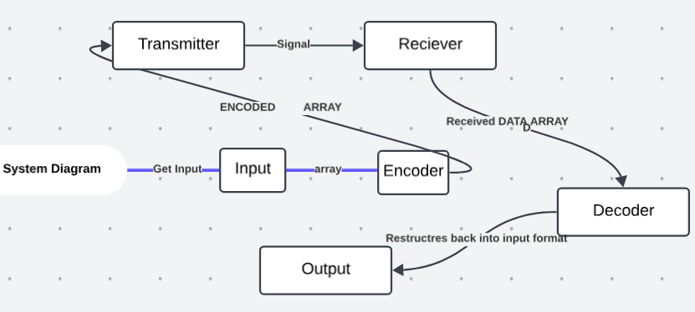
Diagram of Process
Speaker:
Shazil Shahid

Slide 6
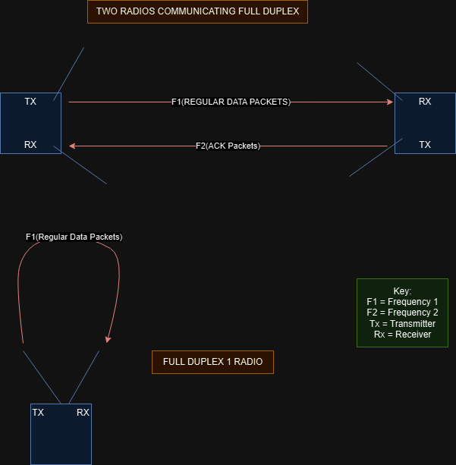
Diagrams of Transmission Systems
Speaker:
Shazil Shahid

Slide 7
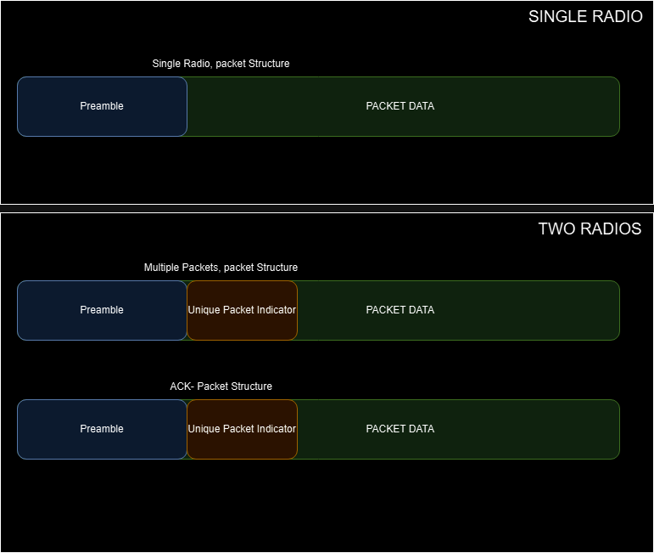
Packet Structures
*note preamble is 11 length barker sequence, which is special sequence that when you cross correlate to find it, the cross correlation will have spikes, so it's good for preambles
Speaker:
James Yackanich

Slide 8
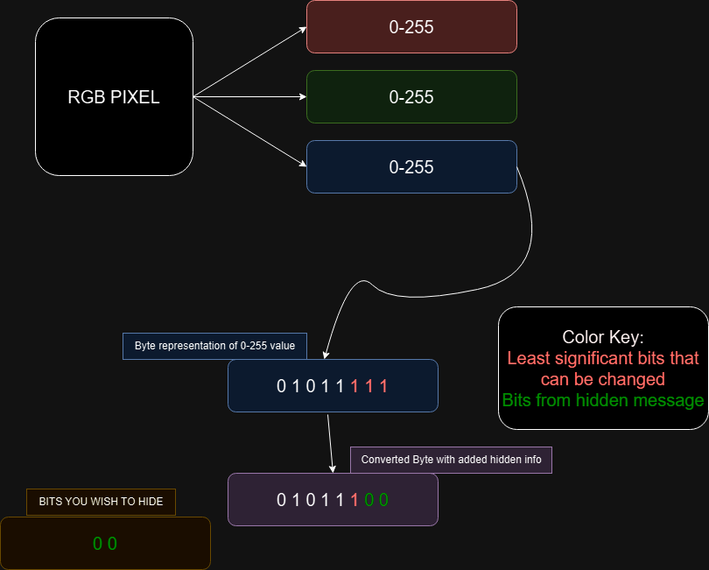
LSB Steganography
Speaker:
James Yackanich

Slide 9
Project Implementation
Speaker:
Juan Rivera
LSB Steganography Implementation
Transmission and Receival of Data through SDRS using single SDR
Simulating DSSS and FHSS
Integrate DSSS methods on working LSB transmissions(One Radio)
Increase Security of LSB method using shared key encryption
Send a single packet over two radios(Two radios able to communicate message hello with acknowledgement)

Slide 10
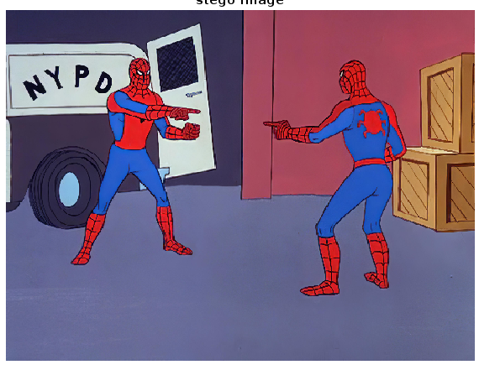
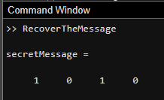
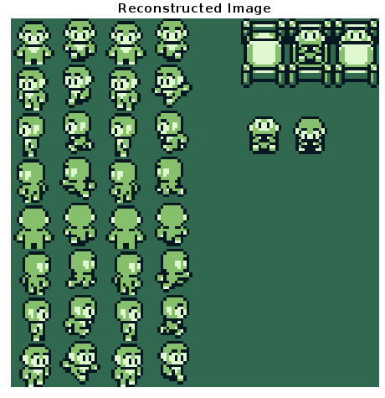

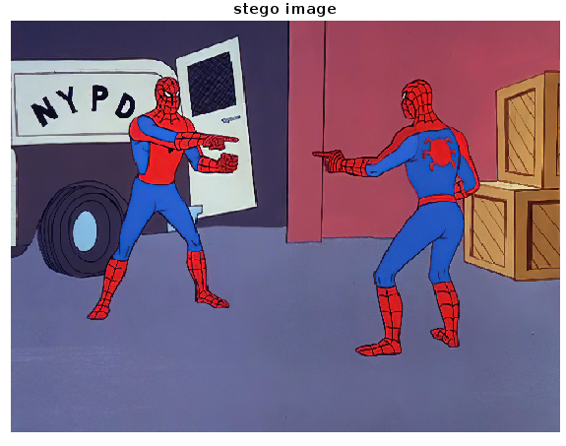
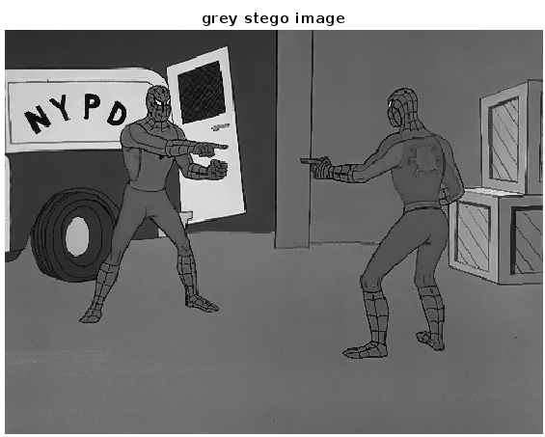
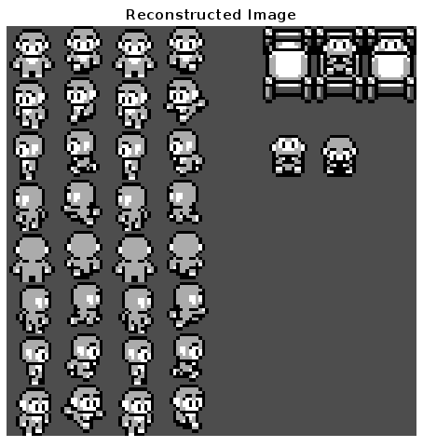

Examples of things we have hidden
*note since your hiding in least significant bits, what you hide has to be smaller and fit inside the host image.
Speaker:
James Yackanich
Payload Calculation(in bits): b = I * 3 * n , where I=number of pixels in host image and n=LSB edited per channel in RGB

Slide 11
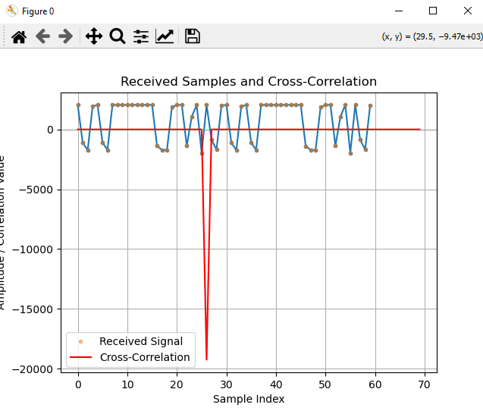
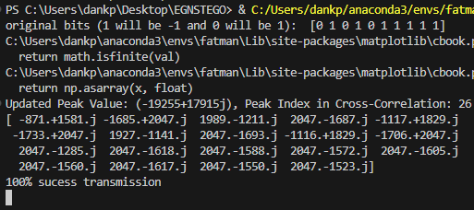
Single Radio Transmission
Speaker:
James Yackanich
*note this transmission repeats each symbol twice

Slide 12
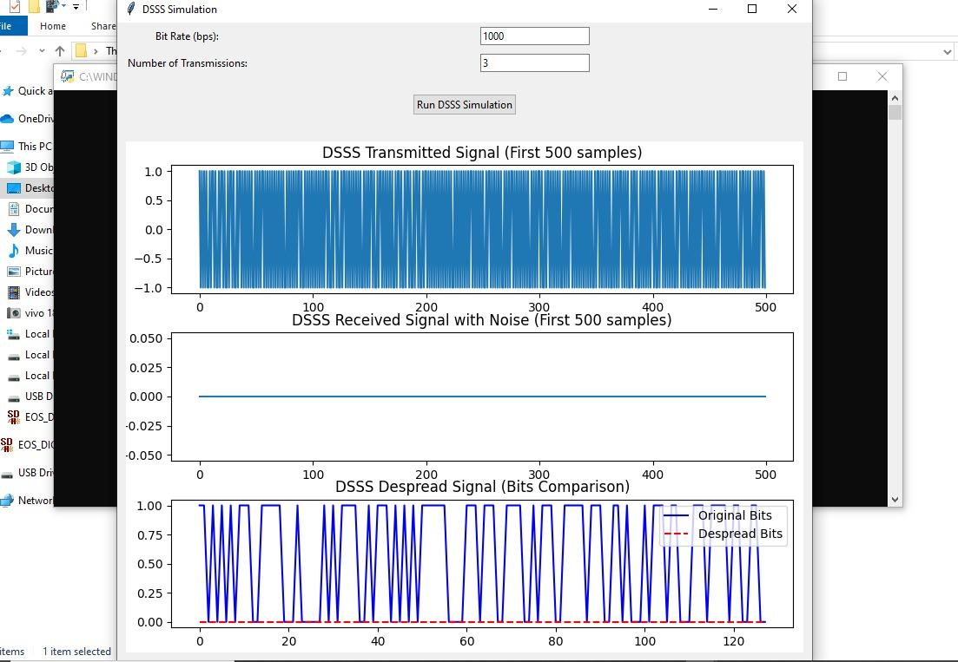
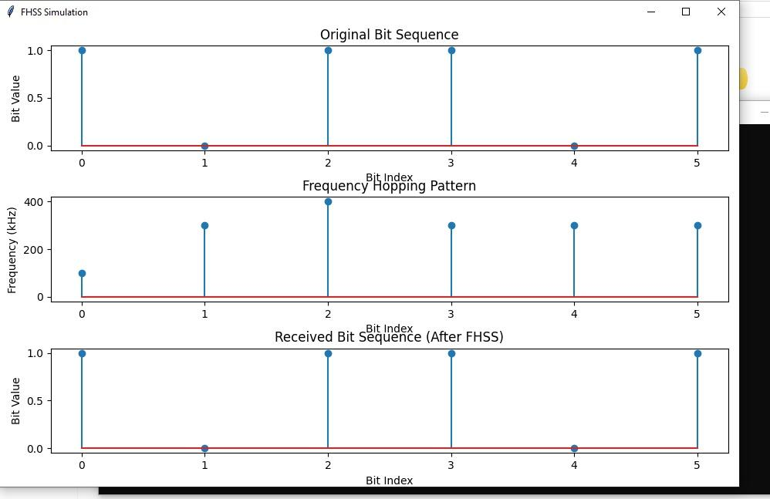
Simulated DSSS and FHSS
Speaker:
Juan Rivera
*Interference Resistance*: The spread-spectrum techniques make the system more resilient to narrowband interference, which is common in real-world wireless environments.
*Security*: to intercept, you would need to crack spreading sequence for DSSS and would need hopping sequence for FHSS

Slide 13
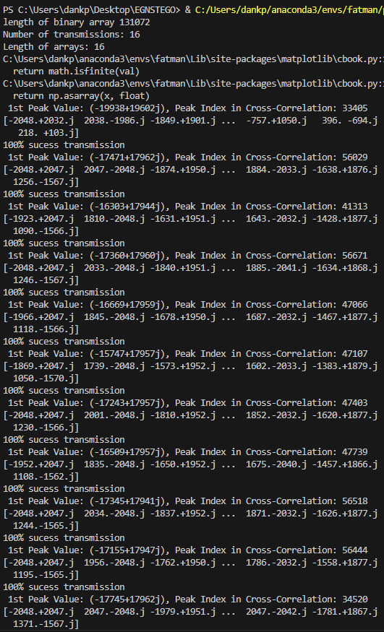
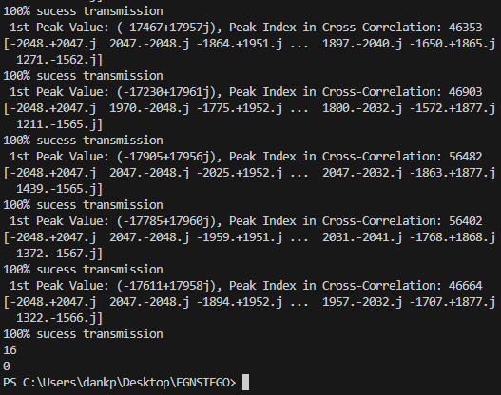


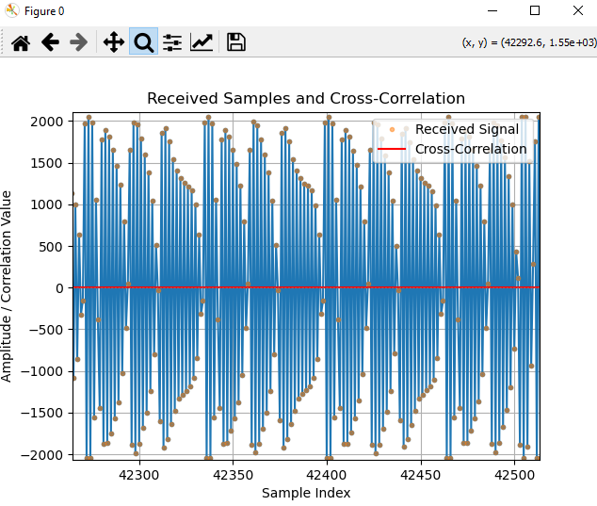
Successful image transmission in packets with small DSSS spreading(1 radio)
Speaker:
James Yackanich

Slide 14
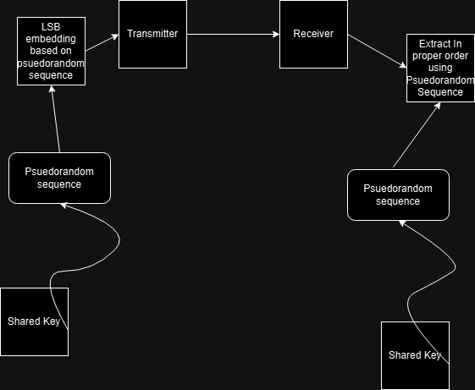
Shared Key Encryption
Speaker:
Juan Rivera

Slide 15
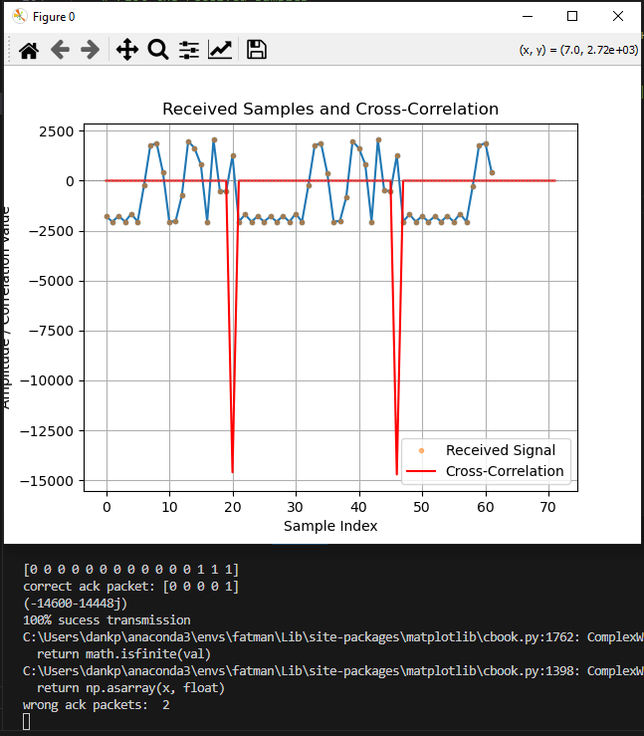
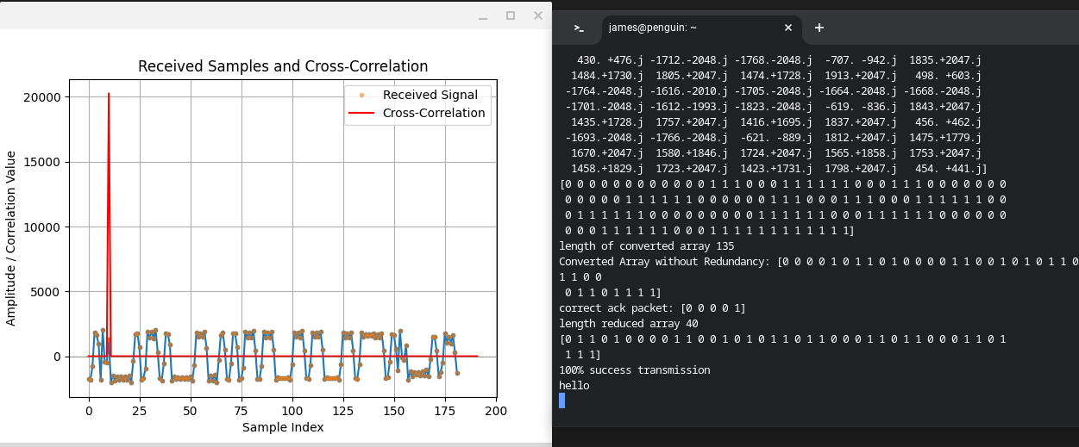
Two Radio Transmission
Speaker:
James Yackanich
Transmitter *note 3 symbols per symbol in this BPSK for error correction
Receiver

Slide 16
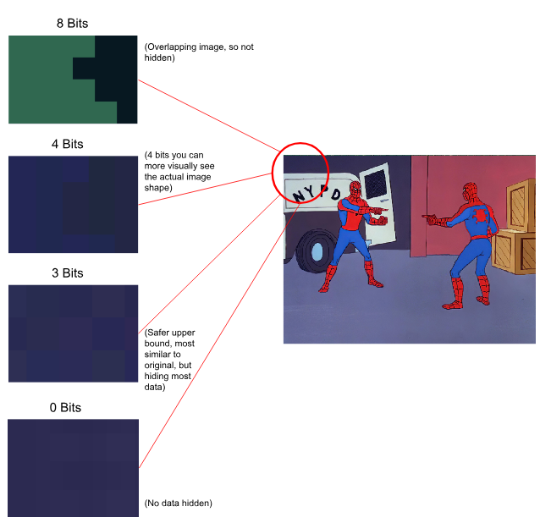
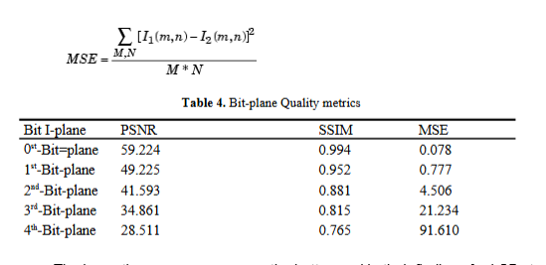
Testing Limits of LSB
Speaker:
Shazil Shahid
Our visual findings:
Data from paper supporting our findings:

Slide 17
What we couldn't do
Speaker:
Juan Rivera
Proper two radio transmission and reception
Lengthen DSSS spreading sequence
Implement FHSS
Implement AI to enhance the data hiding technique/techniques

Slide 18

Demonstration

